Slide 1



G H RAISONI INSTITUTE OF ENGINEERING AND TECHNOLGY, WAGHOLI, PUNE
Department of AI &AIML
VIRTUAL AI ASSISTANT
Guide:
Yogesh Mali
Name of Projectees
1.Kunal Thakre(B41) 2.Vijaykumar Matke(B49)
3.Yashraj Walandikar(B48) 4. Atul Ubale (B45)

Slide 2
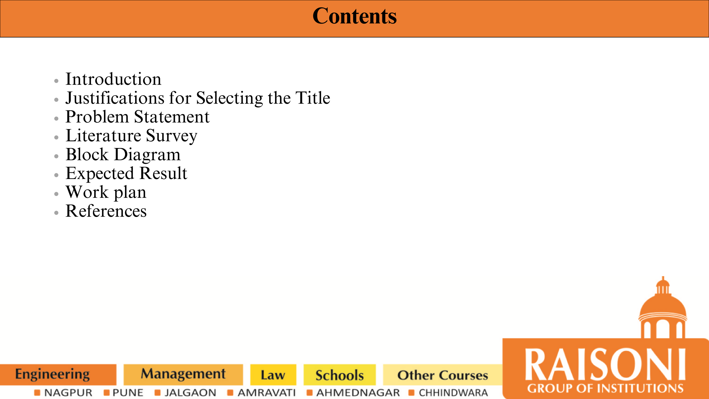

Slide 3
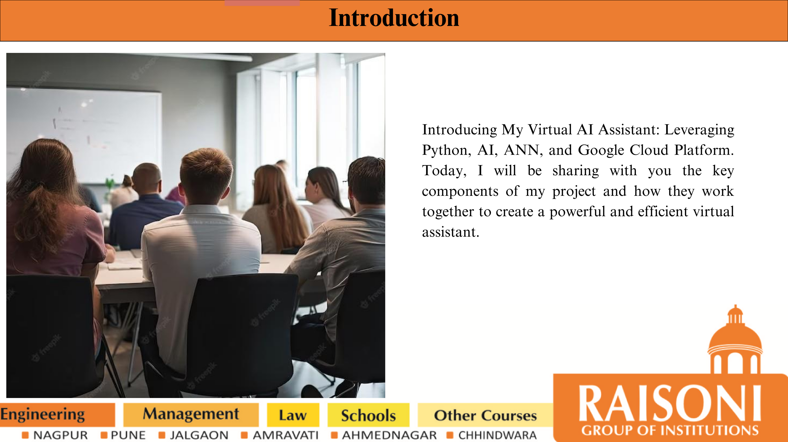

Slide 4
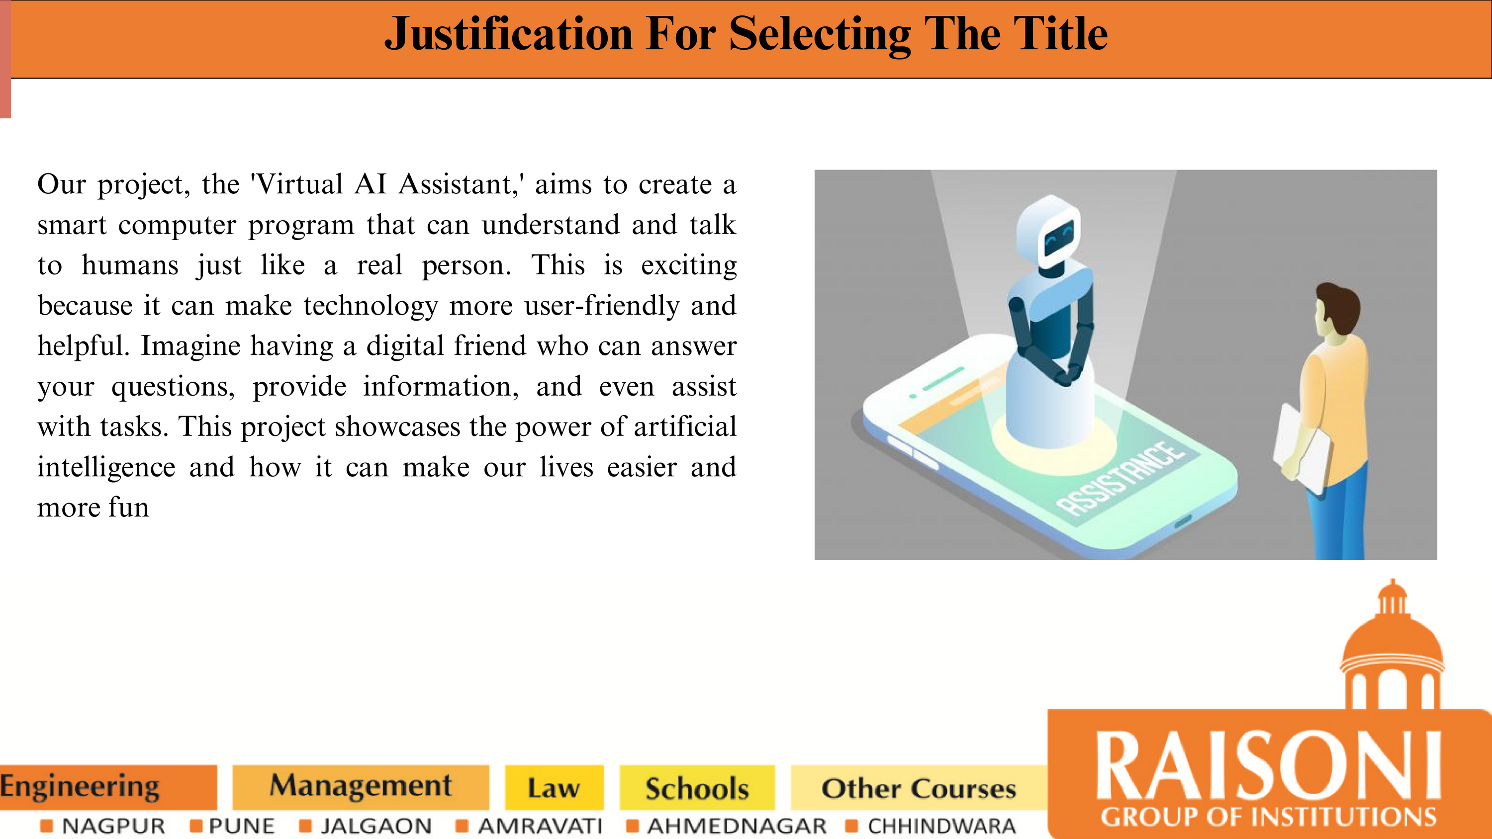

Slide 5
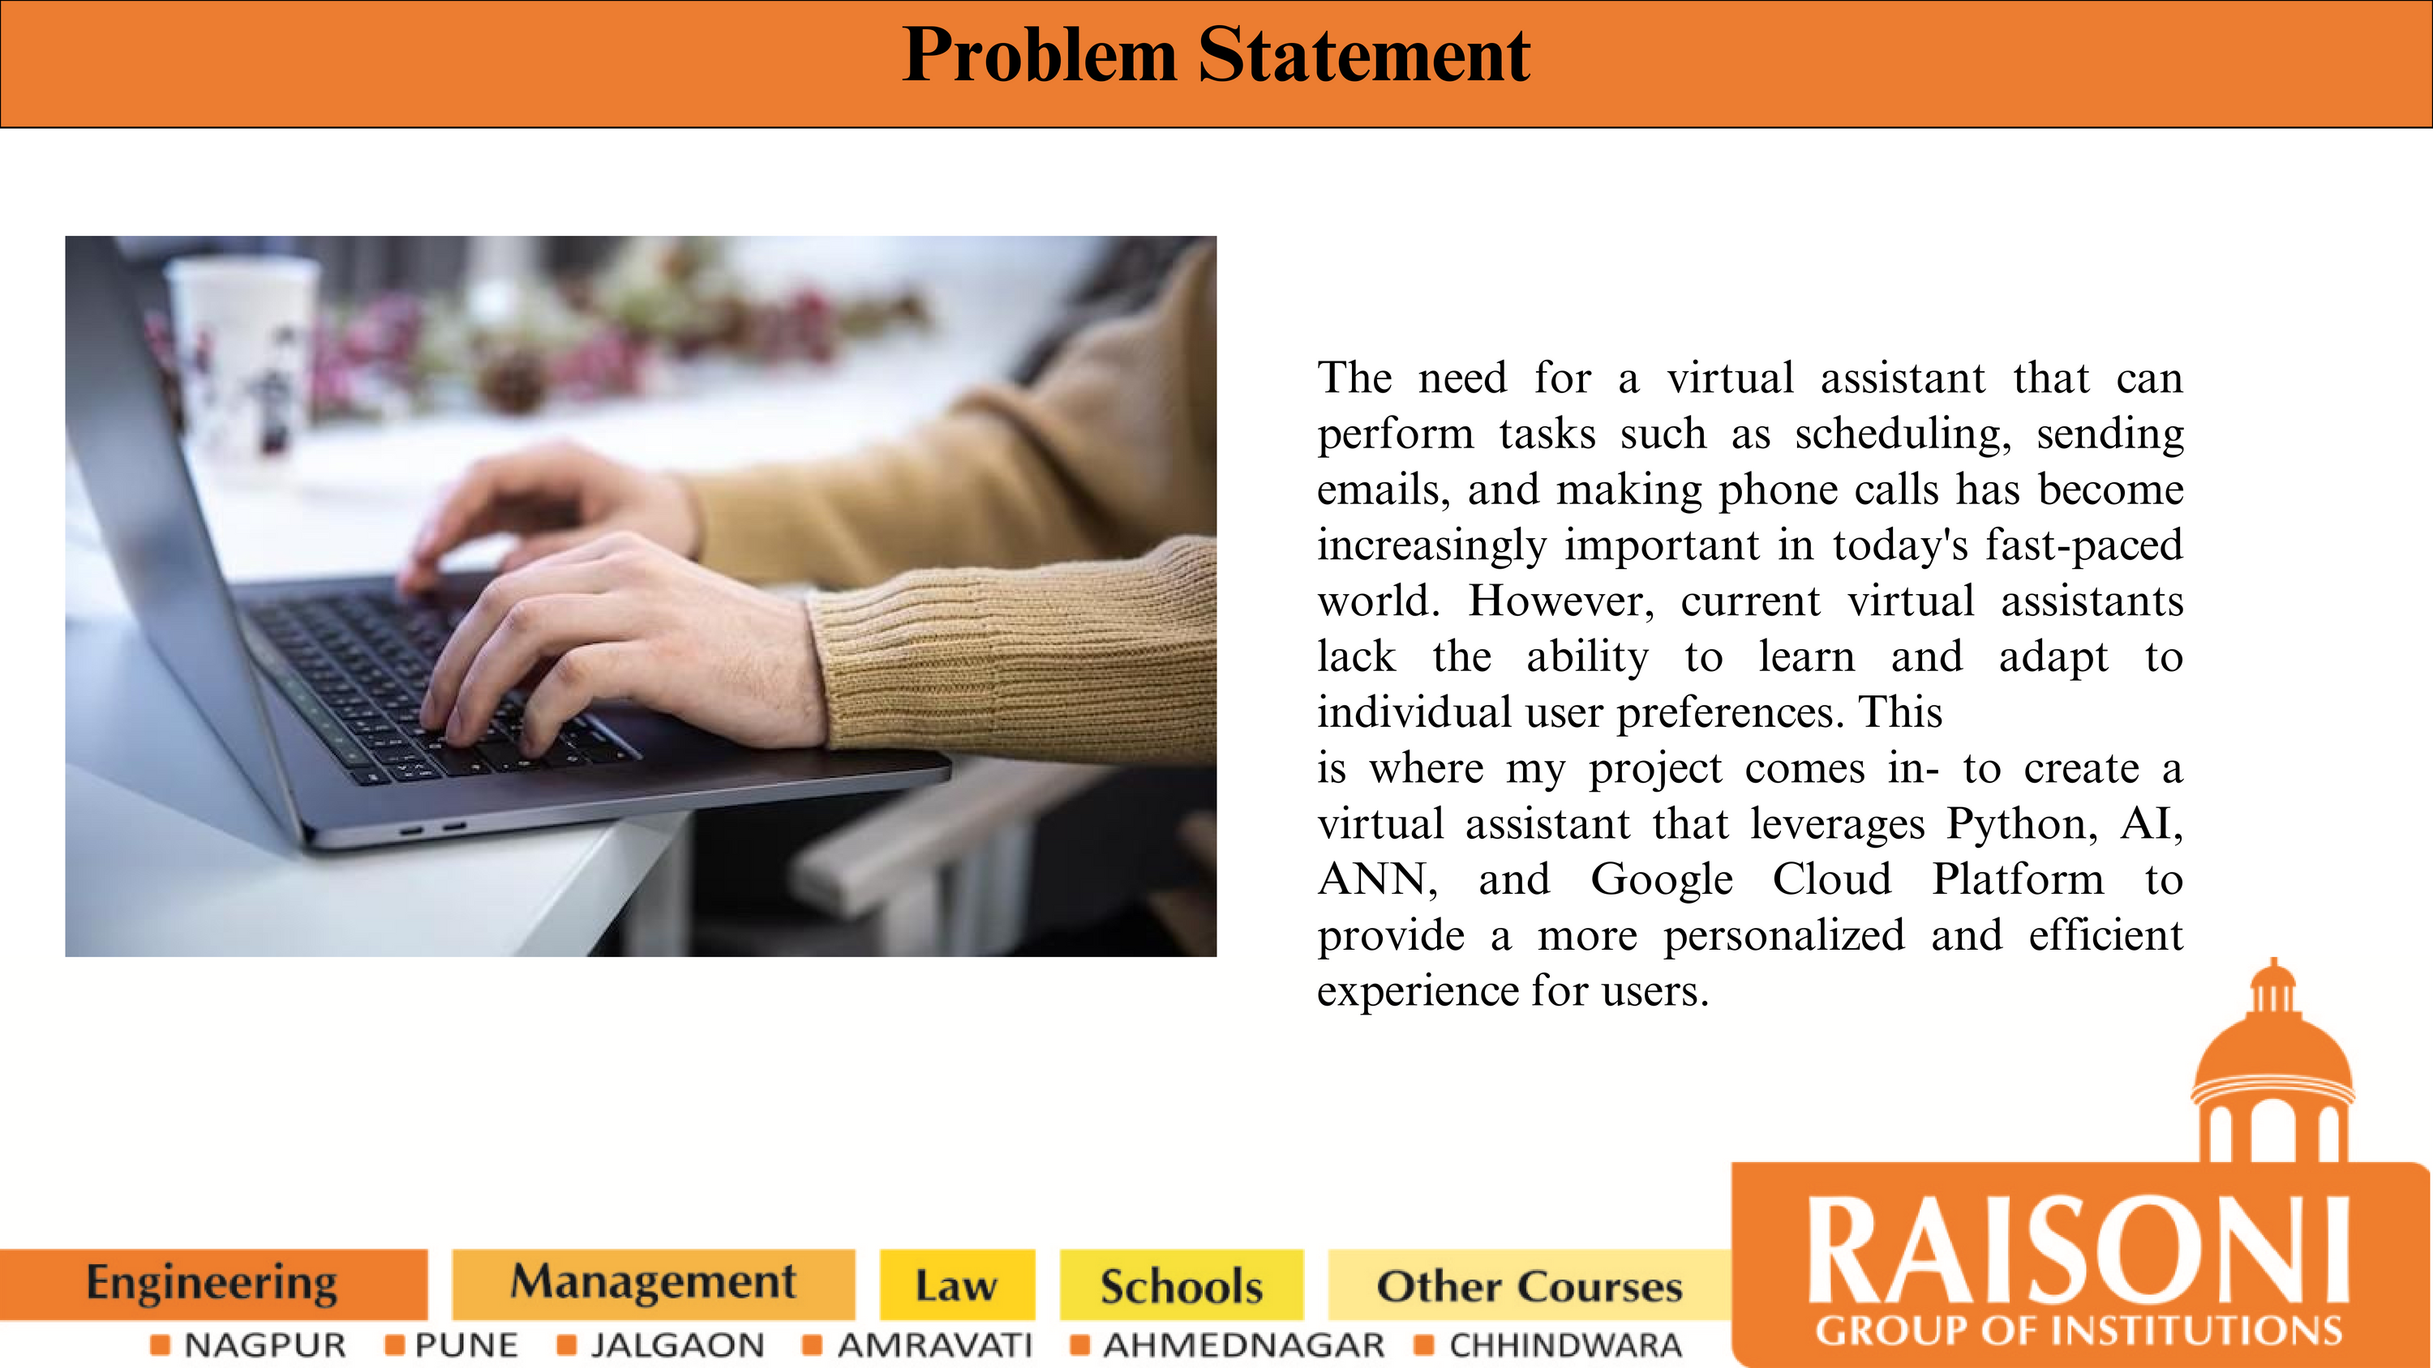

Slide 6
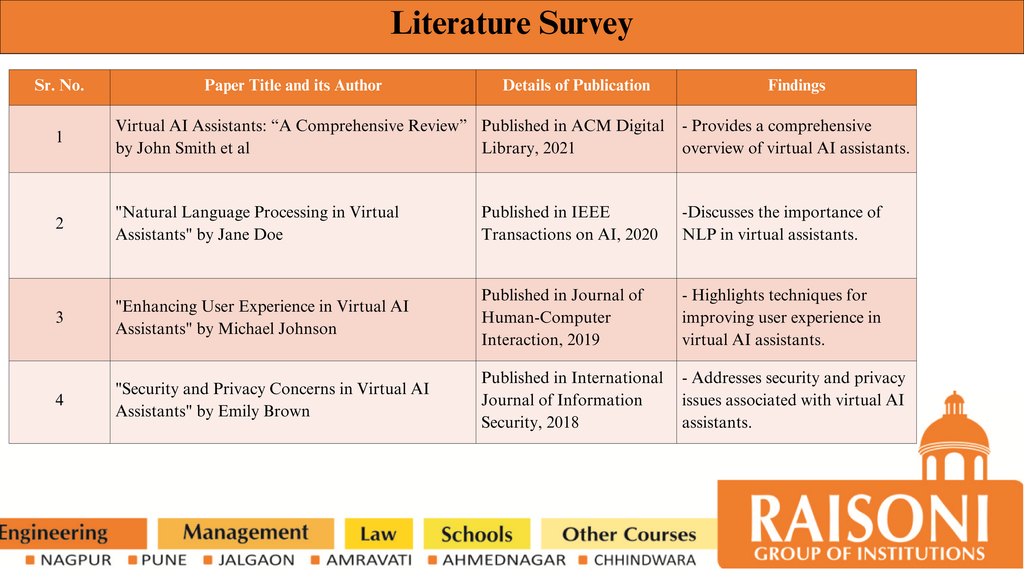

Slide 7
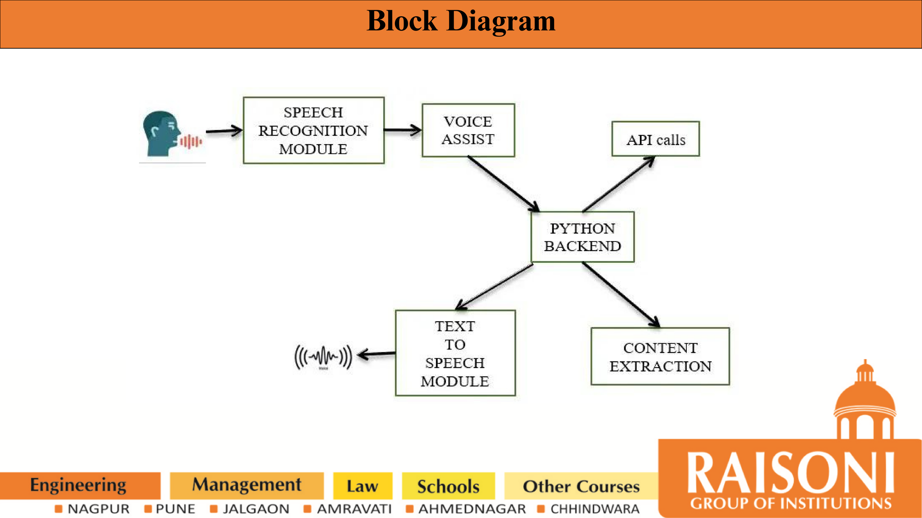

Slide 8
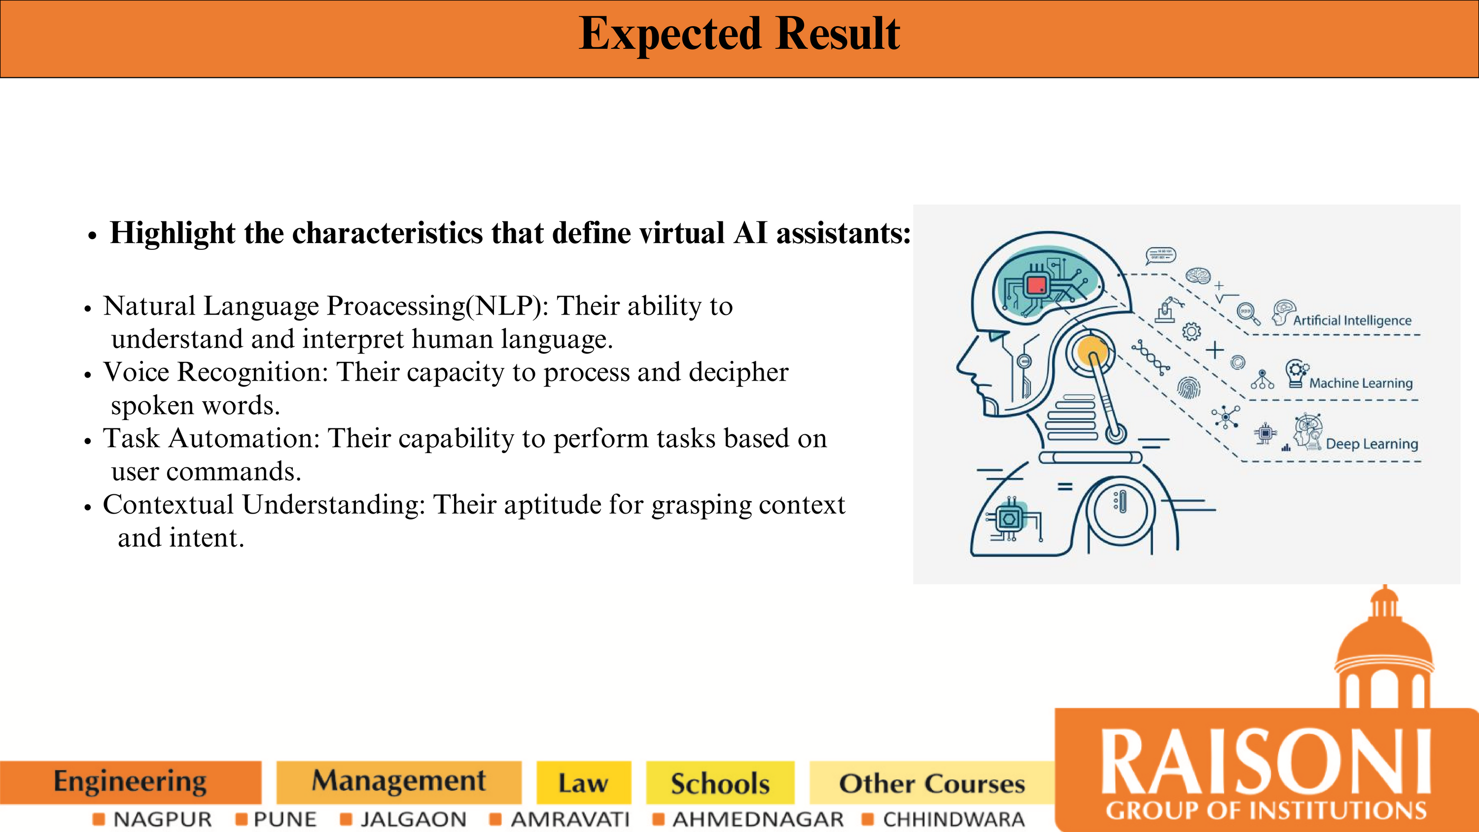

Slide 9
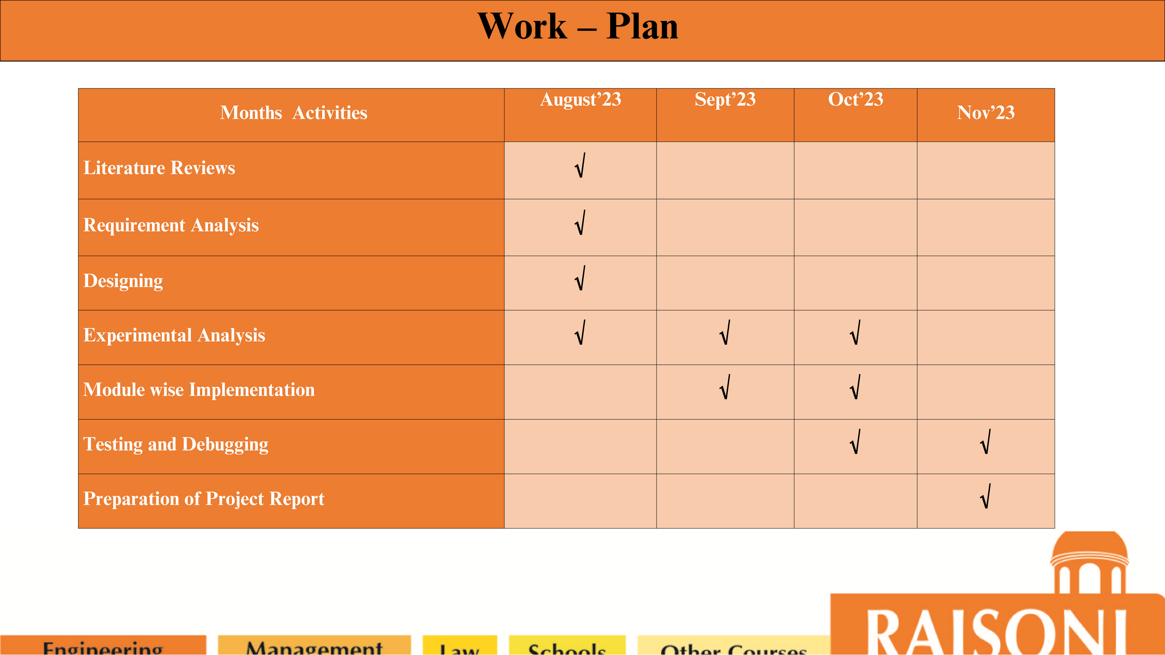

Slide 10
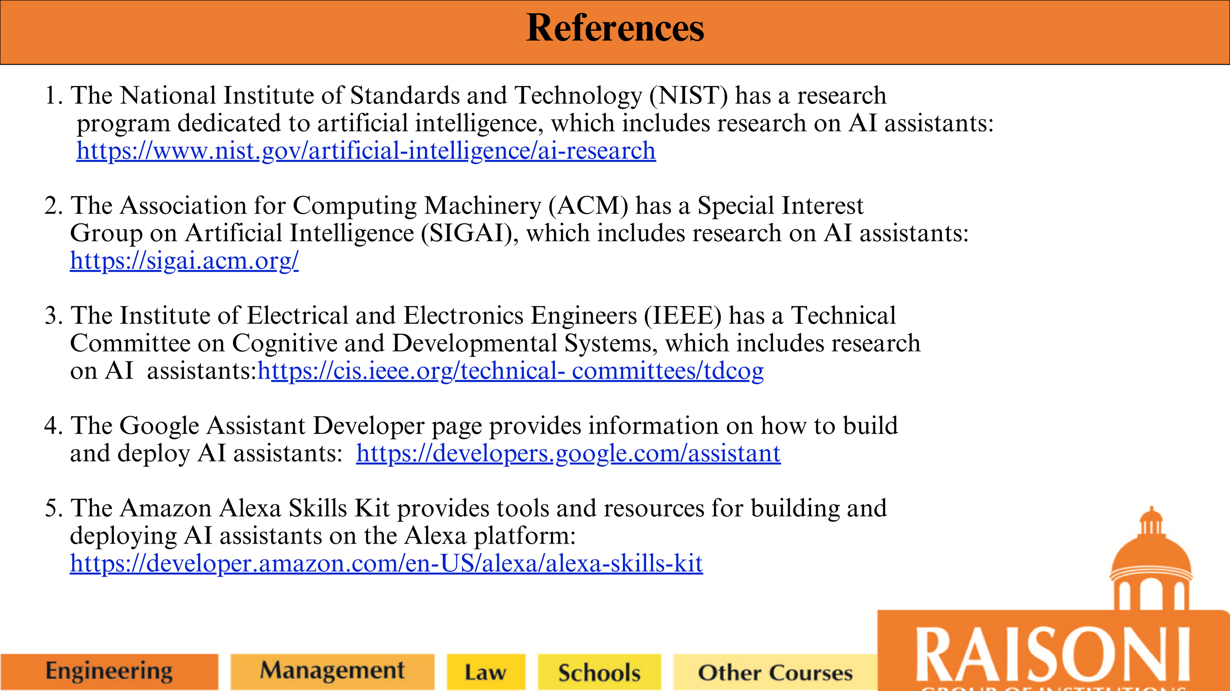

Slide 11


